Slide 1
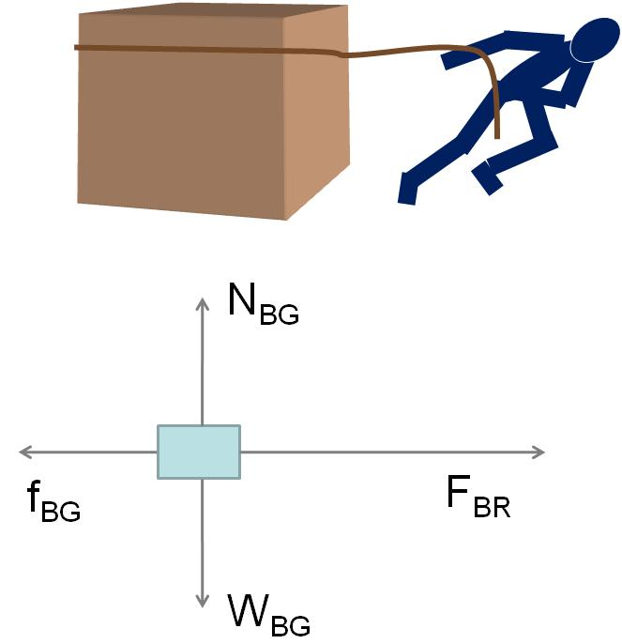

Slide 2
High Potential
Low Potential
E
+ + + + + + + + + + + + + + + + + + + + + + + + + +
+ + + + + + + + + + + + + + + + + + + + + + + + + +
+
A
B
- - - - - - - - - - - - - - - - - - - - - - - - - - - - - -
- - - - - - - - - - - - - - - - - - - - - - - - - - - - - -
d

Slide 3
High Potential
Low Potential
E
Conductor
+ + + + + + + + + + + + + + + + + + + + + + + + + +
+ + + + + + + + + + + + + + + + + + + + + + + + + +
+
A
B
- - - - - - - - - - - - - - - - - - - - - - - - - - - - - -
- - - - - - - - - - - - - - - - - - - - - - - - - - - - - -
d

Slide 4
High Potential
Low Potential
Parabolic electron Path Segments
E
- - - - - - - - - - - - - - - - - - - - - - - - - - - - - -
- - - - - - - - - - - - - - - - - - - - - - - - - - - - - -
+ + + + + + + + + + + + + + + + + + + + + + + + + +
+ + + + + + + + + + + + + + + + + + + + + + + + + +
Conductor

Slide 5
High Potential
Low Potential
E
Conductor
+
- - - - - - - - - - - - - - - - - - - - - - - - - - - - - -
- - - - - - - - - - - - - - - - - - - - - - - - - - - - - -
+ + + + + + + + + + + + + + + + + + + + + + + + + +
+ + + + + + + + + + + + + + + + + + + + + + + + + +
d

Slide 6
-
-
-
-
-
-
-
-
-
E
- - - - - - - - - - - - -
+ + + + + + + + + + +
+
+
+
+
-
-
-
-
+
+
E₂
E₃
-
-
E₁
-
+
+
+
+
-
-
-
-
+
+
E₄
-
-
E₂
E₃
+
+
+
+
-
-
-
-
1
2
3
4

Slide 7
x
+
+
+
+
+
+
E
θ
+
+
z
+
R
+
P
+
+
y
+
+

Slide 8
-
-
-
-
-
-
-
-
-
E
- - - - - - - - - - - - -
+ + + + + + + + + + +
+
+
+
+
-
-
-
-
+
+
E_{net}
E_{net}
E_{net}
-
-
-
+
+
+
+
-
-
-
-
+
+
-
-
+
+
+
+
-
-
-
-
1
2
3
4

Slide 9
Case 1: Negative charges flow to the right
Result: Left side is more positive than before, Right side is more negative than before
Case 2: Positive charges flow to the left
+
+
+
+
Result: Left side is more positive than before, Right side is more negative than before

Slide 10
Current Flow Direction
Electron Flow Direction

Slide 13
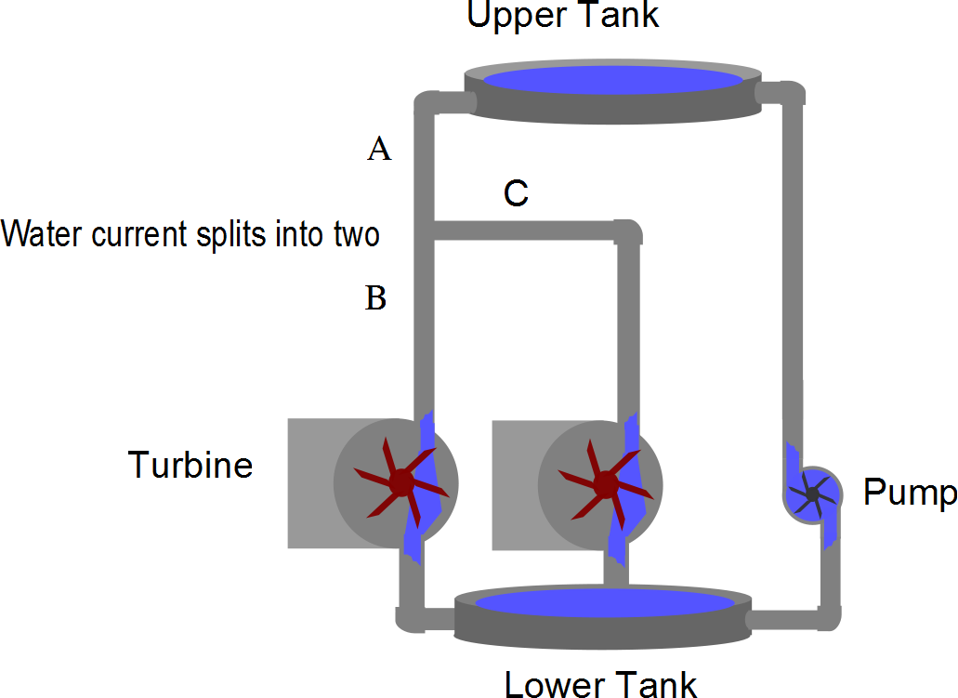
Water current splits into two

Slide 14
